Slide 1
Coding
Lesson One

Slide 2
Introduction to HTML
Today, we are going to learn about HTML and how we can use it to create web pages.

Slide 3
What is HTML?
HTML stands for HyperText Markup Language. It will run on any machine with a proper browser.
HTML is the language that powers the web. All websites use HTML in one form or another.
Pure HTML results in a static (unchanging website), which is why we will later integrate HTML with JavaScript and CSS.

Slide 4
Creating A New HTML File
Open your computer's basic text editor. (ChromeOS: Text, Mac: TextEdit, Windows: Notepad)
Save a blank file as a .HTML file. You may have to enable file extensions on Windows.

Slide 5
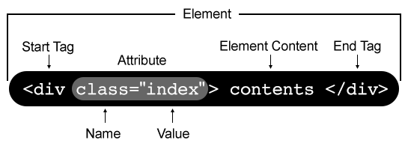
HTML Structure
HTML files are a hierarchy of tags/elements.
There are many kinds of elements in HTML, including text, images, videos, sound and more.

Slide 6
HTML Structure
All HTML files should begin with the declaration <!DOCTYPE html>.
This tells the browser that the information that follows is valid HTML.
The highest level tag is the <html> tag, which should surround all of your code.

Slide 7
HTML Structure
The main part of the document (inside of the <html> tag) is broken into two parts.
Invisible information that the browser needs to know goes into the <head> tag.
Visible elements that should be displayed on screen go into the <body> tag.

Slide 8
Adding Headings
There are six types of heading tags in HTML. (h1-h6)
The largest heading tag is h1.
The smallest heading tag is h6.

Slide 9
Adding Links
The <a> tag allows you to add links to your page.
The <a> tag is also a good example of using attributes in tags.

Slide 10
Comments
Comments are used to add notes to code for humans to read.
Comments help developers understand and organize their code.
HTML comments begin with <!-- and end with -->
Comments can also be used to temporarily remove a piece of code that you may want to reactivate later.

Slide 11
Homework
Install Visual Studio Code. Visual Studio Code is an IDE (code editor) developed by Microsoft that we will be using in class to create our web pages. You can download it for free from https://code.visualstudio.com/.
Go to https://github.com/atticuscornett to view lesson files.
If you need assistance, contact me at atticusccornett@gmail.com.

